Slide 1
Basics of Cloud computing
TASK-1
-MALAVIKA.S

Slide 2
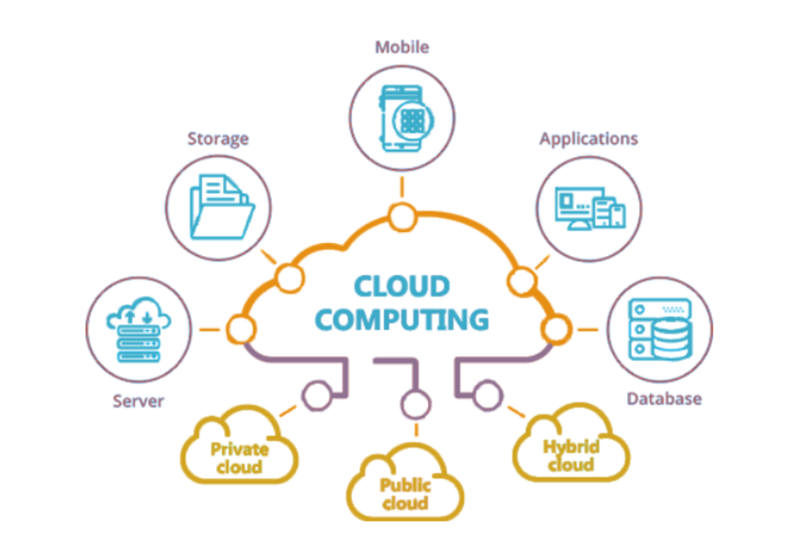
CLOUD COMPUTING
Cloud Computing means storing and accessing the data and programs on remote servers that are hosted on the internet instead of the computer's hard drive or local server.

Slide 3
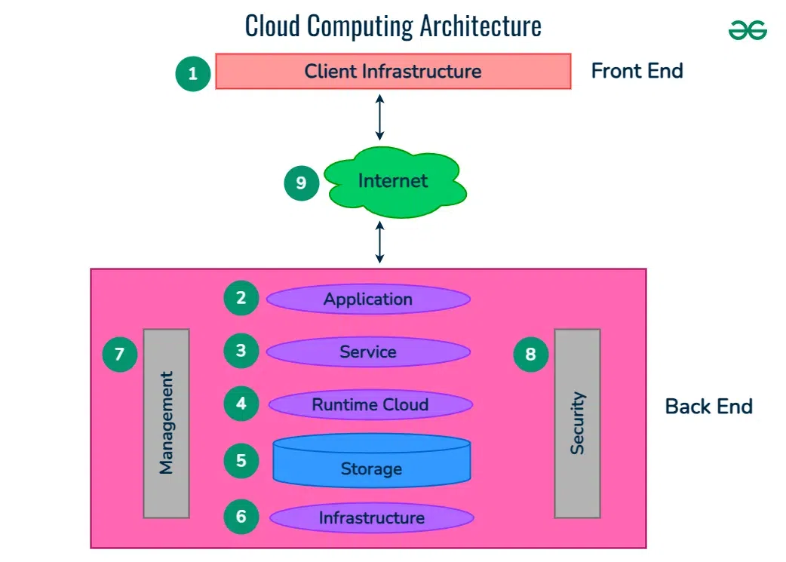
Architecture Of Cloud Computing
Front end ( Fat client, Thin client)
Back-end platforms ( Servers, Storage )
Cloud-based delivery and a network ( Internet, Intranet, Intercloud )

Slide 4
Cloud Service Models
Infrastructure as a Service ( IaaS ) – provides virtualized computing resources (e.g., storage, servers)
PaaS (Platform as a Service) – provides a platform for developers to build and deploy applications.
SaaS (Software as a Service) – Delivers software applications over the internet (e.g., Google Workspace, Microsoft 365).

Slide 5
Cloud service providers
Amazon Web Services (AWS)
Microsoft Azure
Google Cloud Platform (GCP)

Slide 6
Cloud Deployment Models
Private Deployment Model - Services offered over the internet and shared among multiple customers (e.g., AWS, Azure).
Public Deployment Model - Used exclusively by one organization, often hosted internally or by a third party.
Hybrid Deployment Model - Combines both public and private clouds to allow data and applications to move between them.

Slide 7
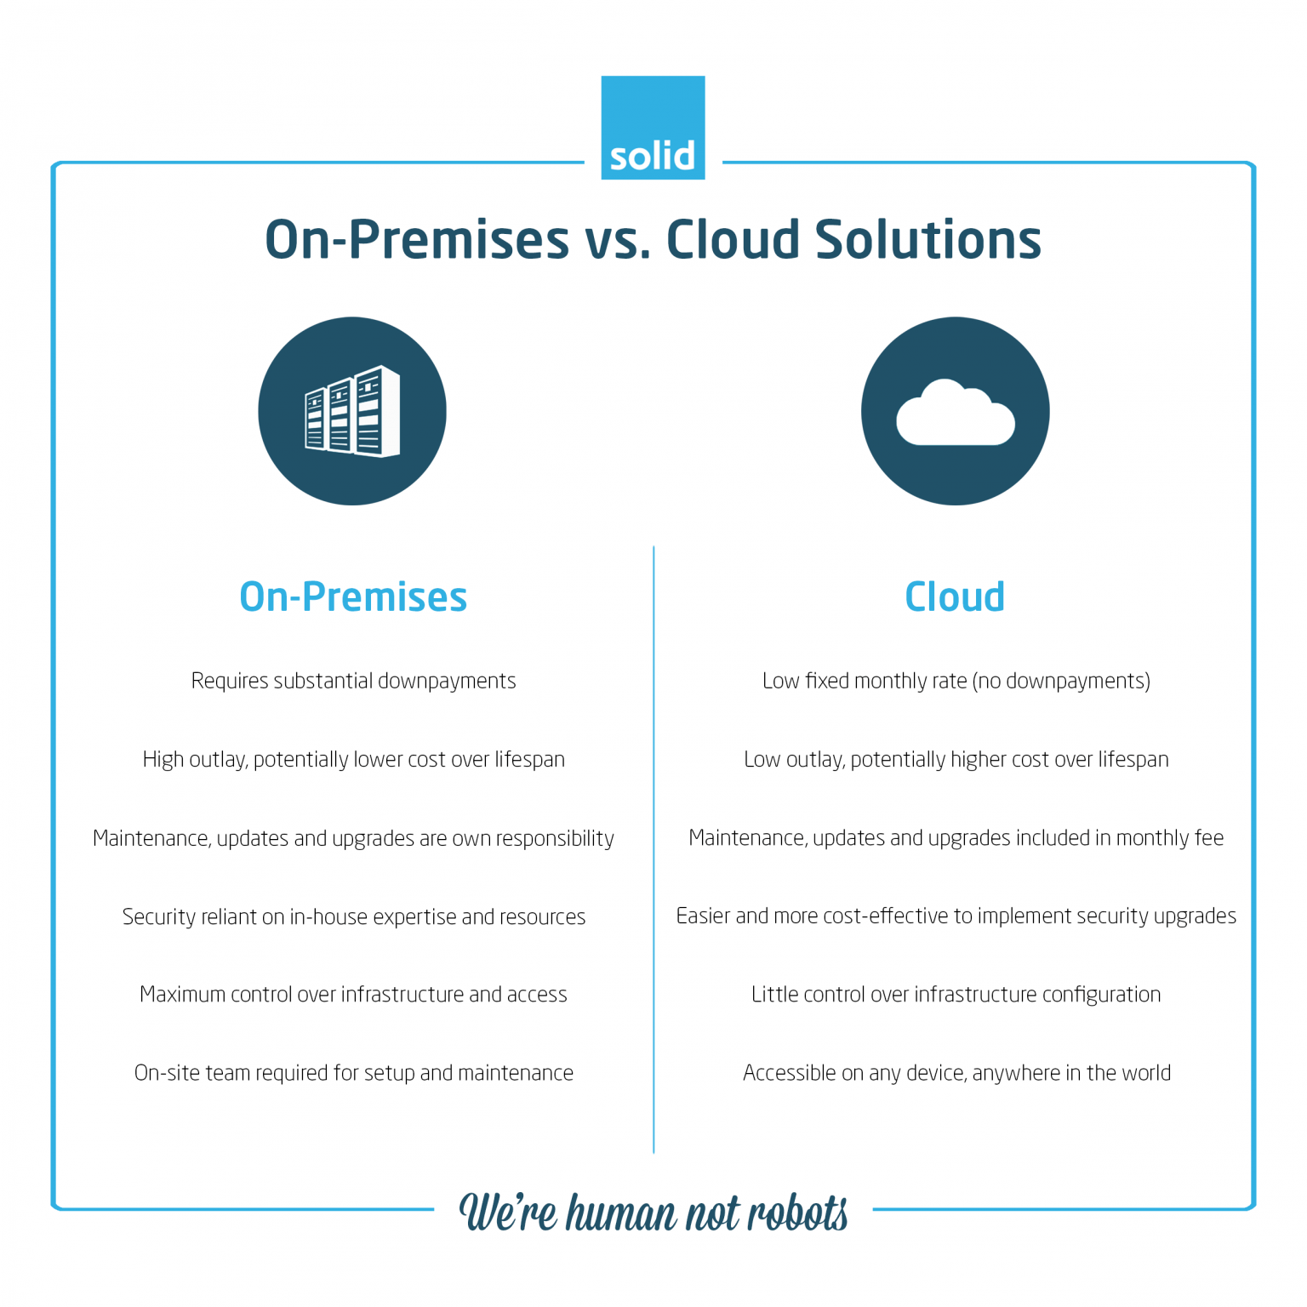

Slide 8
Characteristics Of Cloud Computing
Scalability - With Cloud hosting, it is easy to grow and shrink the number and size of servers based on the need.
Reliability - Rather than being hosted on one single instance of a physical server, hosting is delivered on a virtual partition that draws its resource, such as disk space, from an extensive network of underlying physical servers
Physical Security - The underlying physical servers are still housed within data centers and so benefit from the security measures that those facilities implement to prevent people from accessing or disrupting them on-site.

Slide 9
AWS
Amazon Web Service (AWS) is the world’s leading cloud computing platform by Amazon. It offers on-demand computing services, such as virtual servers and storage, that can be used to build and run applications and websites.

Slide 10
Benefits
Cost Efficiency
No need for upfront hardware costs.
Pay-as-you-go pricing.
Scalability
Instantly scale up or down based on demand.
Flexibility & Accessibility
Access services and data from anywhere with internet connectivity.
Performance
Providers offer high-performance servers, storage, and databases with
global reach.
Security
Enterprise-level security and compliance features (encryption, identity
management, etc.).

Slide 11
Disaster Recovery
Built-in backup and recovery options without the need for a separate disaster recovery setup.
Automatic Updates
Providers manage software and infrastructure updates.
Collaboration
Teams can collaborate in real-time using cloud-based tools.

